Slide 1
CURRENCY CONVERTER SYSTEM (Using Tkinter)
Presented by:-
Nikhil pal (RA2311028030038)
Ashwin Chaudhary (RA2311028030034)
Arnav Tomar (RA2311028030030)
Aryan Verma (RA2311028030033)

Slide 2
Introduction
Overview:
The currency converter is a software application designed to simplify the process of converting one currency to another using real-time exchange rates.
In today’s global economy, travelers and businesses frequently need to convert currencies. This tool aims to provide a user-friendly solution.
Purpose:
To develop a simple and effective application that allows users to easily convert currencies through an intuitive graphical user interface (GUI).

Slide 3
Idea
Concept:
The idea behind the currency converter is to facilitate easy currency conversions for users without requiring complex calculations or external resources.
Key Features:
User-friendly interface with dropdown menus for selecting currencies.
Ability to input the amount to be converted.
Display of conversion results clearly and concisely.
Technologies Used:
Programming Language: Python
GUI Library: Tkinter (built-in library for creating GUI applications in Python)

Slide 4
Working
How It Works:
User Input:
The user enters an amount and selects the currencies (from and to) using dropdown menus.
Conversion Process:
Upon clicking the "Convert" button, the application retrieves the exchange rate from a hardcoded dictionary.
The application calculates the converted amount using the formula: Converted Amount=Amount×Exchange Rate

Slide 5
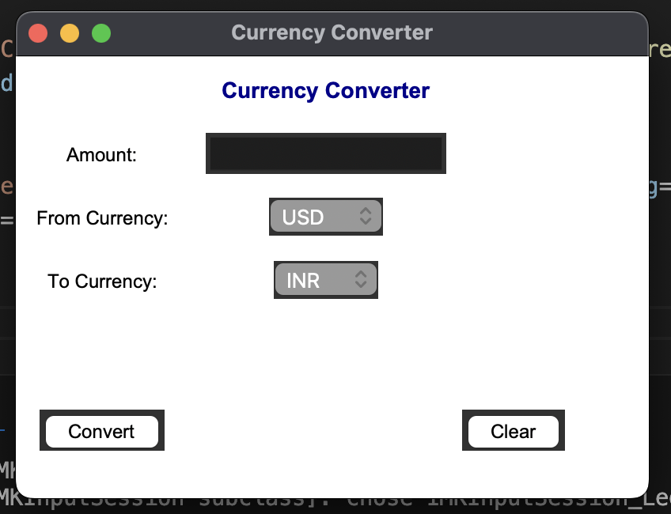
Displaying Results:
The result is displayed immediately below the input section for user convenience.

Slide 6
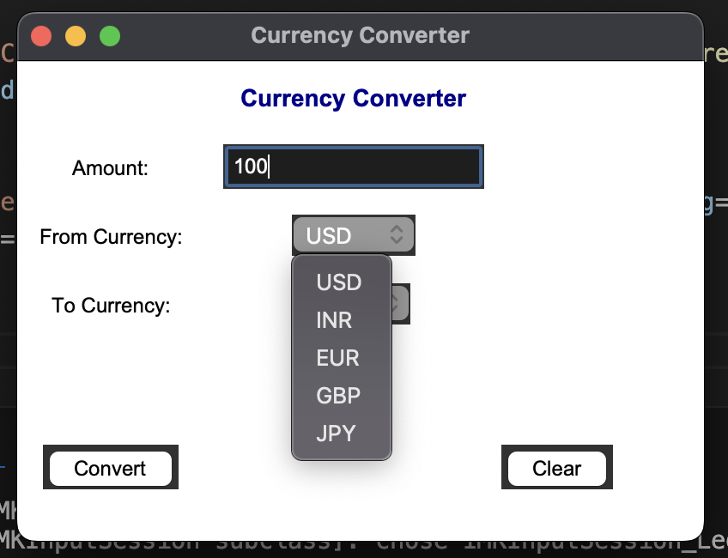
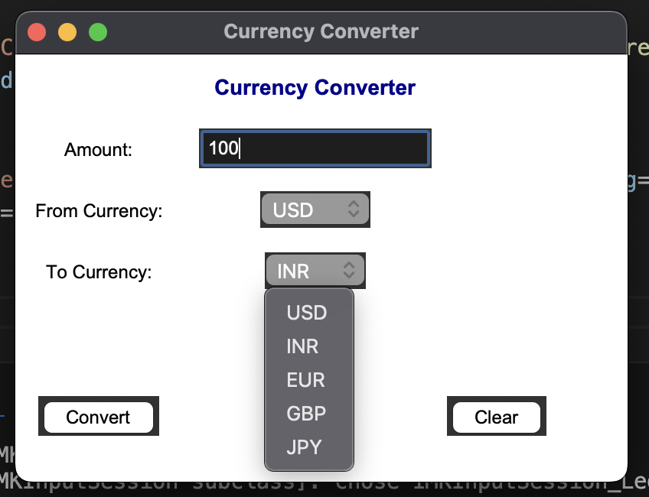

Slide 7
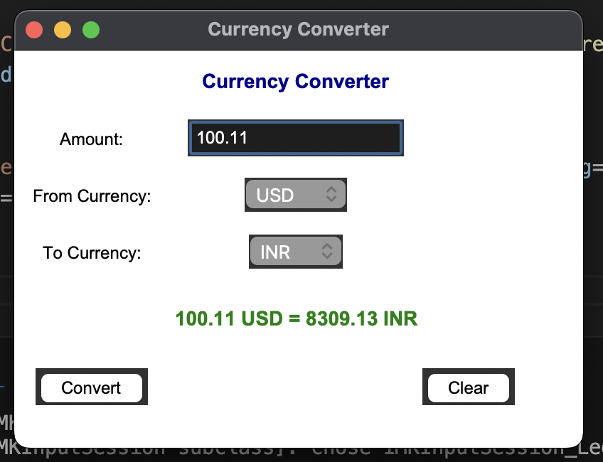

Slide 8
Result
Outcome:
The currency converter successfully performs conversions for various currencies such as USD, INR, EUR, GBP, and JPY based on hardcoded exchange rates.
User Interface:
The application features a clean, simple, and intuitive design that enhances the user experience.
Sample Conversion:
For example, converting 100 USD to INR yields 8300 INR (using an exchange rate of 83.0).
Future Enhancements:
Incorporate real-time exchange rates by using APIs.
Add more currencies to broaden its functionality.
Enhance the UI/UX for a more polished appearance.

